Slide 1
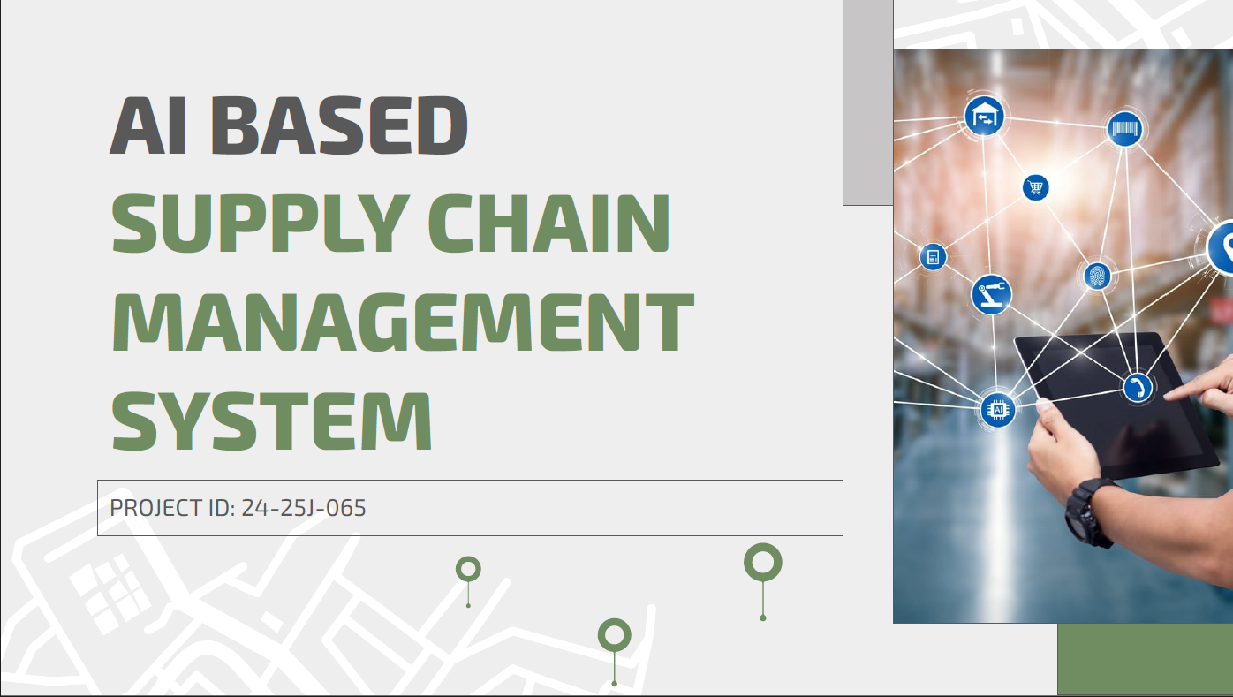

Slide 2






MEET THE TEAM
GROUP LEADER
MEMBER
MEMBER
MEMBER
Mahagedara D N
Widanapathiran Y M
Dilshan KTDN
Weerasinghe WMSRM

Slide 3
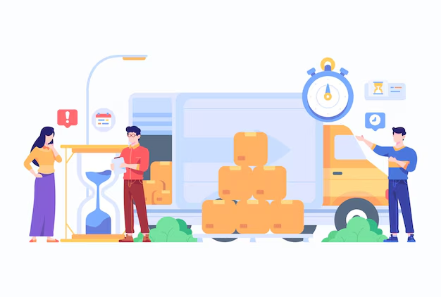
Introduction
Overview of Project
●AI driven Supply chain management system
●Target Audience - Small - Medium Scale Garments
Importance and Relevance
●In the garment industry, several supply chain management systems are in use, but there are few or less systems that uses the AI technologies to optimise the overall system complexity and cost
Key Features
●Production scheduling and optimization
●Logistics and Transportation Optimization
●Logistics and Packing Optimization for Transportation
●Supplier Selection and Evaluation

Slide 4

Research question
How can artificial intelligence be utilized to optimize supply chain management in the garment industry, focusing on production scheduling, logistics, packing, and supplier evaluation to achieve cost reduction and improved efficiency?

Slide 5
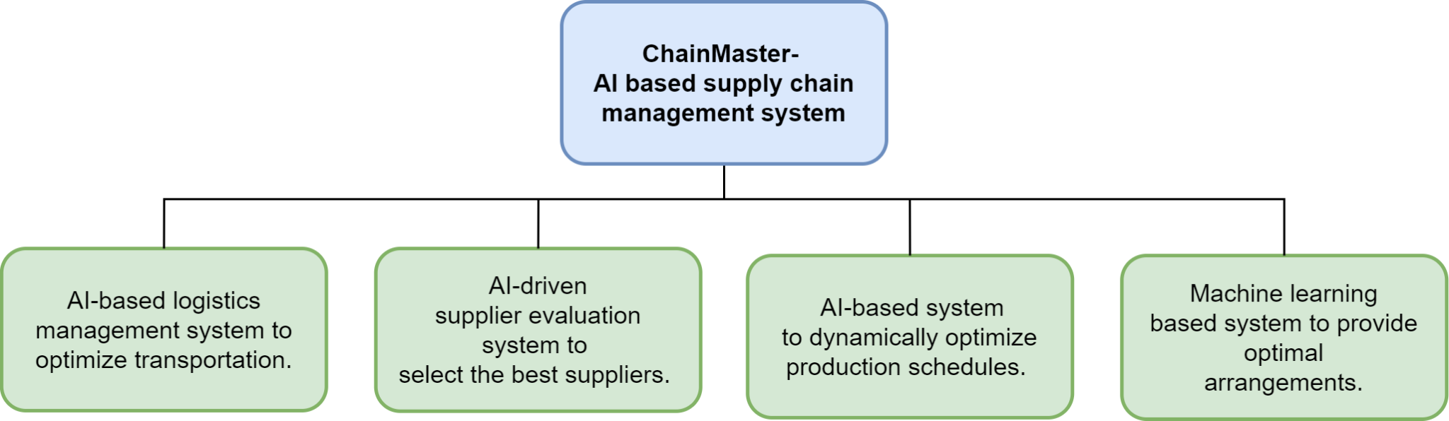
Objectives

Slide 6
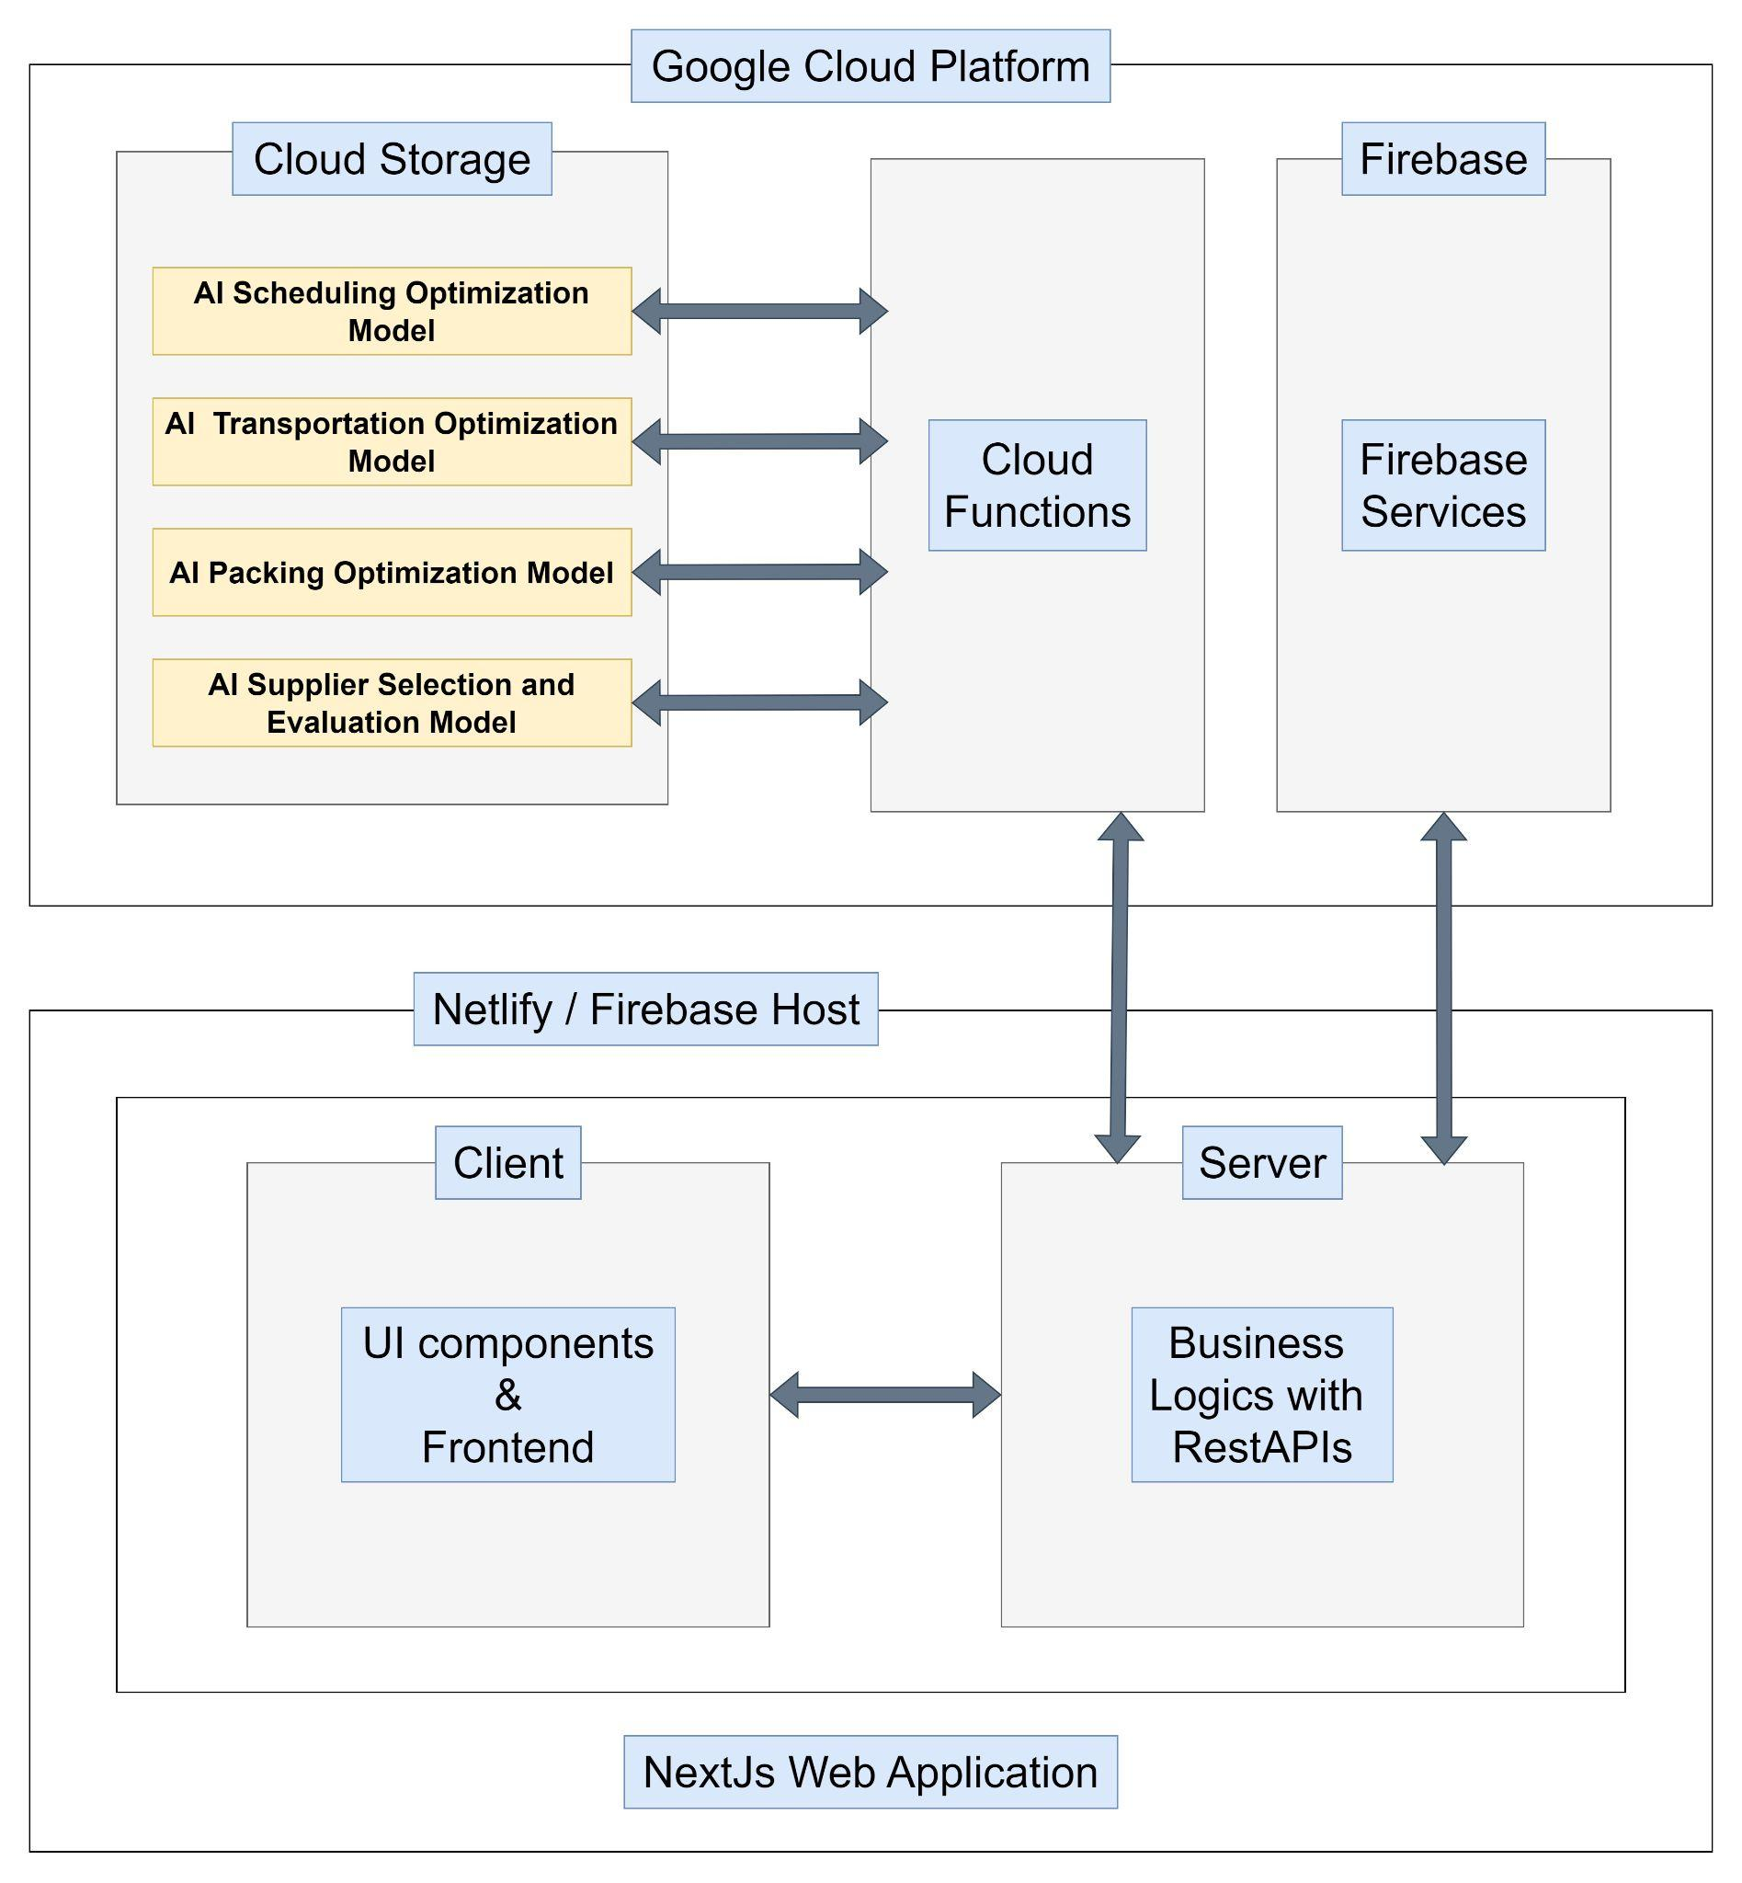
SYSTEM ARCHITECTURE (OVERALL)

Slide 7
IT21167614 | Mahagedara D N
Software Engineering (SE)
IT21167614| Mahagedara D N | 24-25J-65

Slide 8
Individual Research Problem
Production Scheduling And Optimizations
How to plan and schedule production item deliveries more accurately and optimize each production line by identifying bottlenecks.
IT21167614| Mahagedara D N | 24-25J-65

Slide 9
Individual Objectives
Create an AI solution to predict order delivery times more accurately.
Develop an application-level solution to identify bottlenecks in production lines.
Integrate the predictive model into the backend system.
Collect historical data on delivered items from garment production.
IT21167614| Mahagedara D N | 24-25J-65

Slide 10
Research Gap
Study | Travel and collect data | High accuracy | low cost
Create an AI solution to predict order delivery times more accurately. | YES | YES | NO
Develop an application-level solution to identify bottlenecks in production lines | YES | YES | YES
Minimalistic UI designs with high usability | NO | YES | YES
IT21167614| Mahagedara D N | 24-25J-65

Slide 11
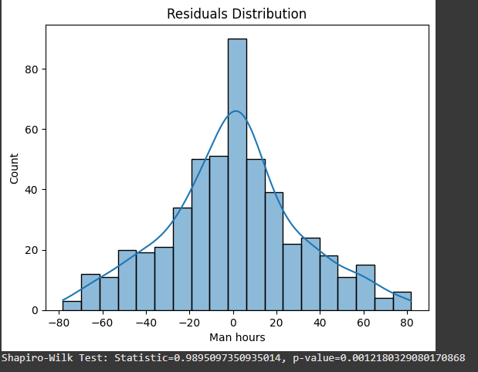
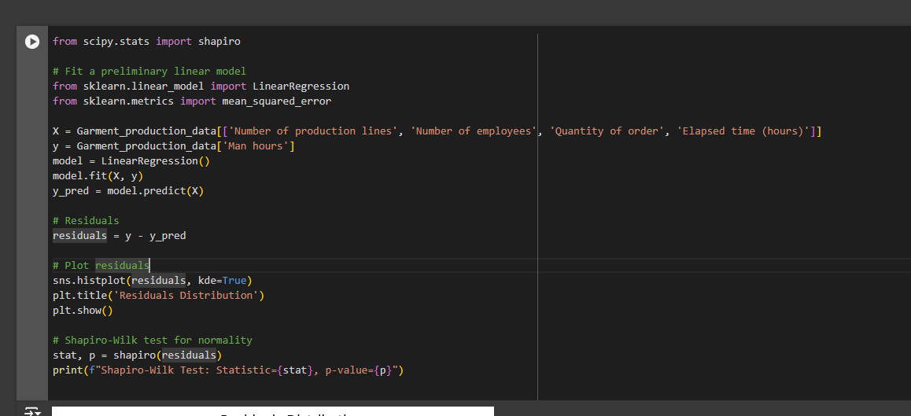
Developed part
ML Model To Estimate accurate delivery time
IT21167614| Mahagedara D N | 24-25J-65

Slide 12
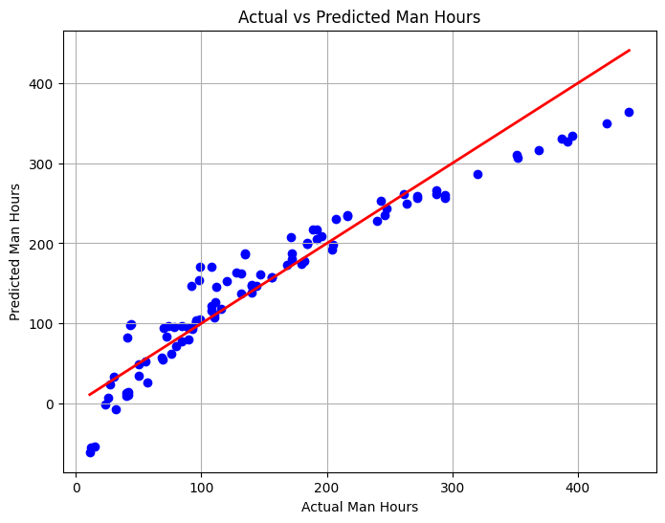
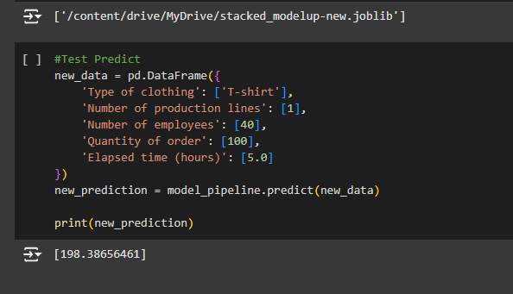
Developed part cont…
IT21167614| Mahagedara D N | 24-25J-65

Slide 13
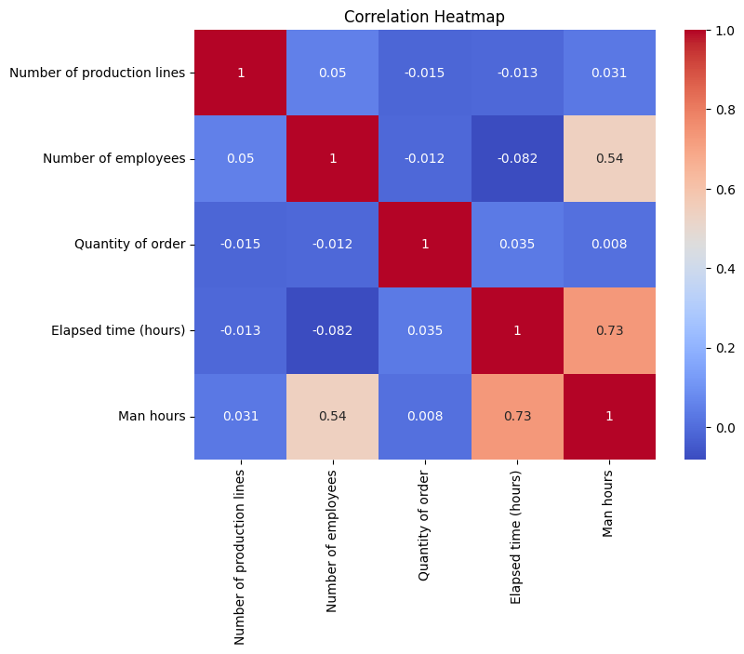
Developed part cont…
Deliver time estimating Model implementation
RandomForest and Python seamlessly handle data manipulation and preprocessing & ensuring efficiency. Flask server for API integration with the Model.
IT21167614| Mahagedara D N | 24-25J-65

Slide 14
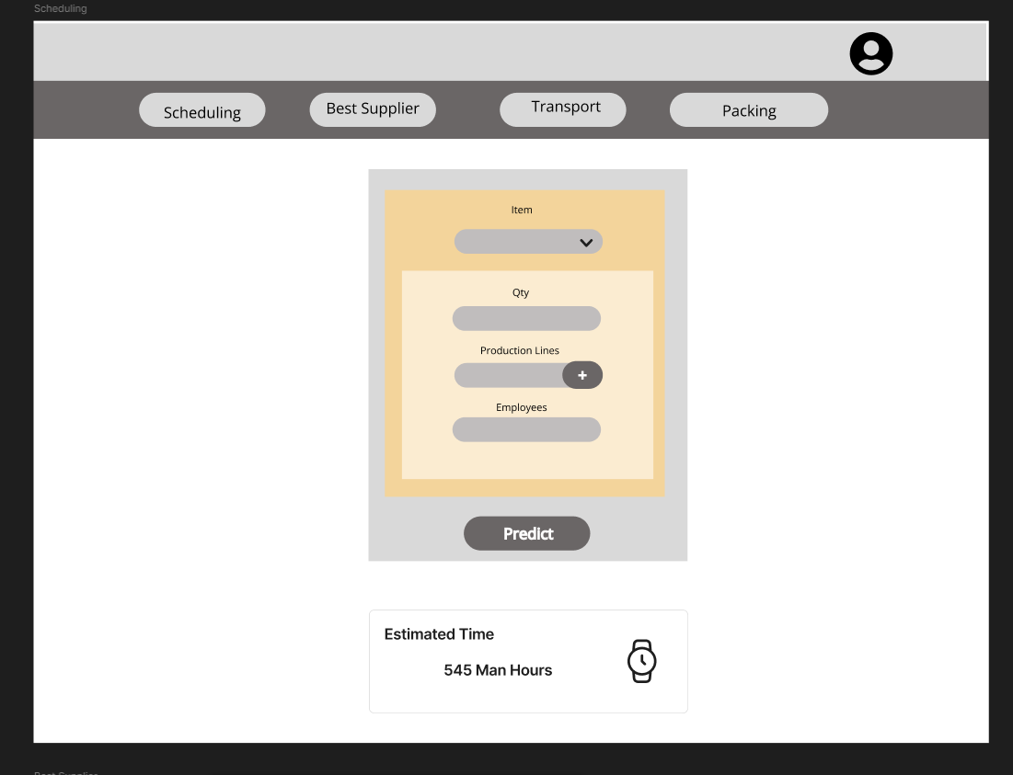
Prototype

Slide 15
Commercial Value
Able to commercialize the product into small - medium scaled garments to improve their efficiency
Publish the application to commercial downloads
IT21167614 | Mahagedara D N | 24-25J-65

Slide 16
References
[1] scikit-learn, "sklearn.ensemble.RandomForestClassifier," [Online]. Available: https://scikit-learn.org/1.5/modules/generated/sklearn.ensemble.RandomForestClassifier.html. [Accessed: Dec. 1, 2024].
[2] Kaggle, "Your Home for Data Science," [Online]. Available: https://www.kaggle.com/. [Accessed: Dec. 1, 2024].
[3] Goodfellow, Y. Bengio, and A. Courville, Deep Learning. Cambridge, MA, USA: MIT Press, 2016. [Online]. Available: https://www.deeplearningbook.org/
IT21167614| Mahagedara D N | 24-25J-65

Slide 17
IT21312144 | Widanapathirana Y.R.
Software Engineering (SE)
IT21312144 | Widanapathirana Y.R.| 24-25J-65

Slide 18
Individual Research Problem
How can machine learning algorithms be utilized to accurately assess supplier performance based on historical data, quality metrics, and cost efficiency?
IT21312144 | Widanapathirana Y.R.| 24-25J-65

Slide 19
Individual Objectives
Design an AI-driven scoring model to evaluate suppliers based on cost, quality, delivery timelines, and defect rates.
Develop a data processing pipeline to collect and preprocess supplier performance metrics.
Integrate supplier scoring results into a centralized decision-support system.
IT21312144 | Widanapathirana Y.R.| 24-25J-65

Slide 20
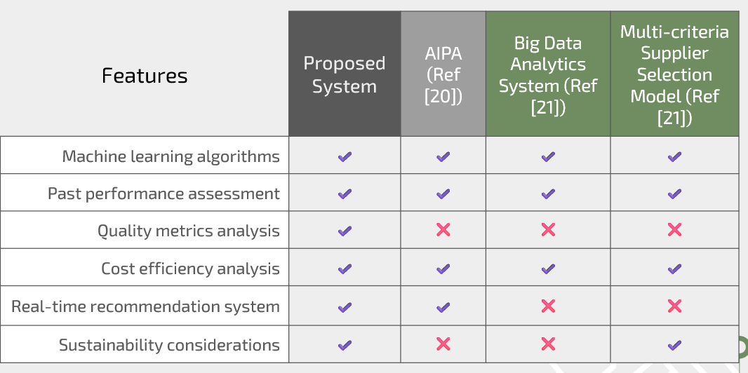
Research Gap
IT21312144 | Widanapathirana Y.R.| 24-25J-65

Slide 21
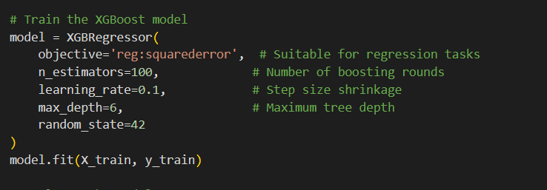
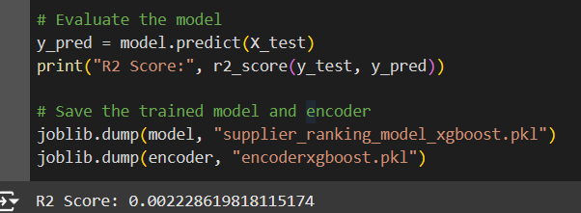
Developed part
ML Model To Estimate a score to the Supplier according to the history of the Supplier.
IT21312144 | Widanapathirana Y.R.| 24-25J-65

Slide 22
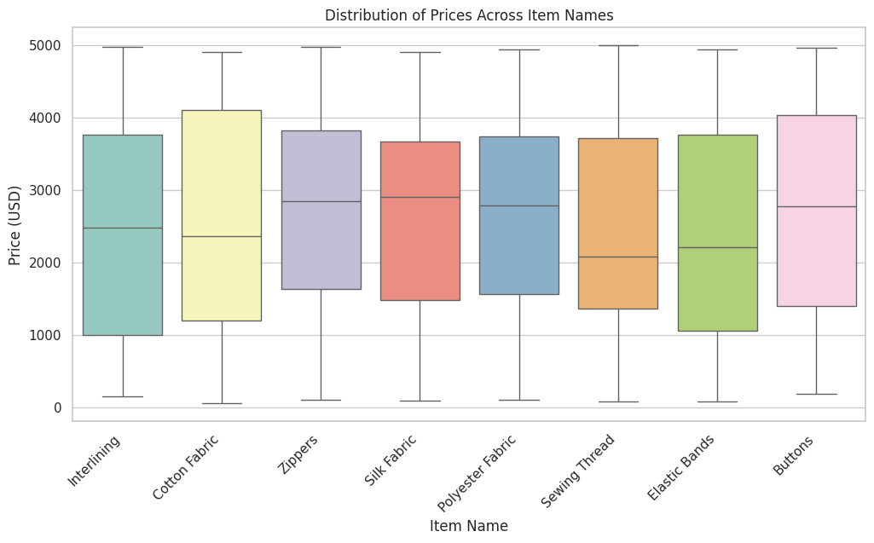
Developed part
IT21312144 | Widanapathirana Y.R.| 24-25J-65

Slide 23
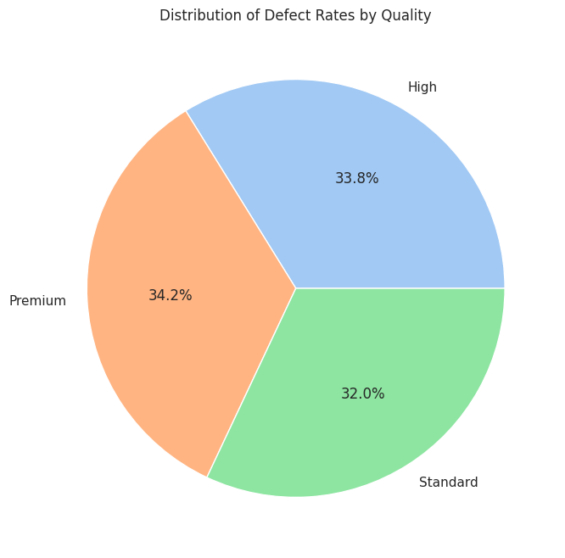
Developed part
IT21312144 | Widanapathirana Y.R.| 24-25J-65

Slide 24
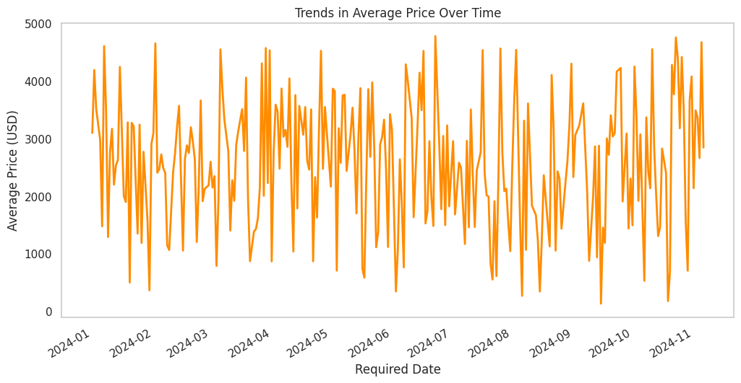
Developed part
IT21312144 | Widanapathirana Y.R.| 24-25J-65

Slide 25
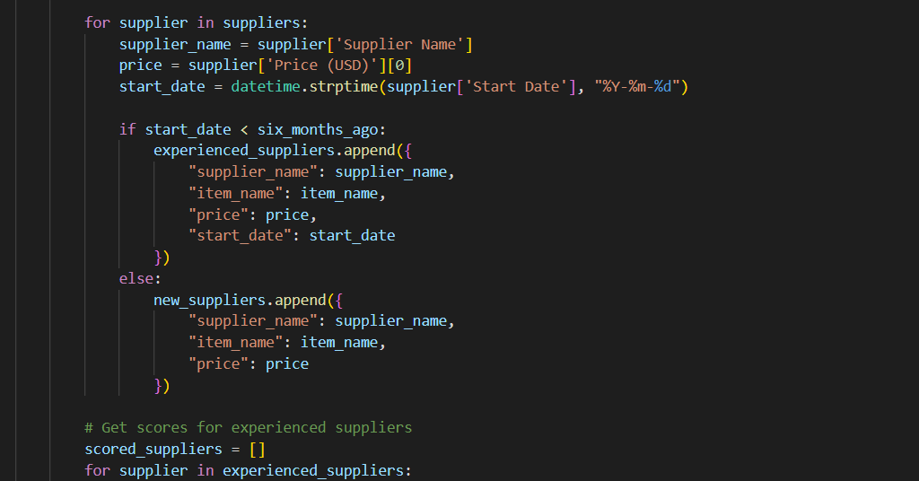
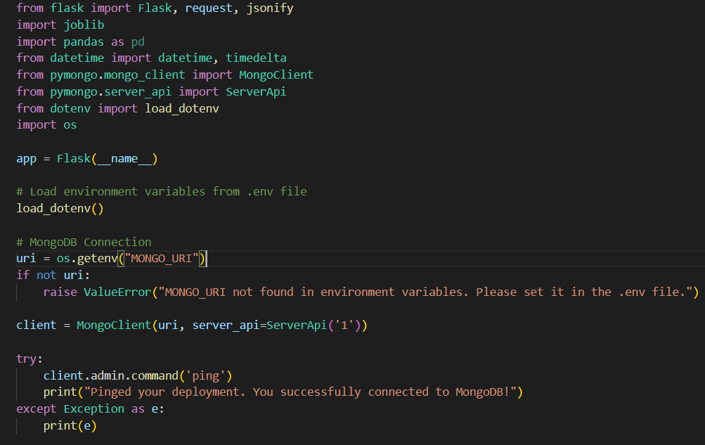
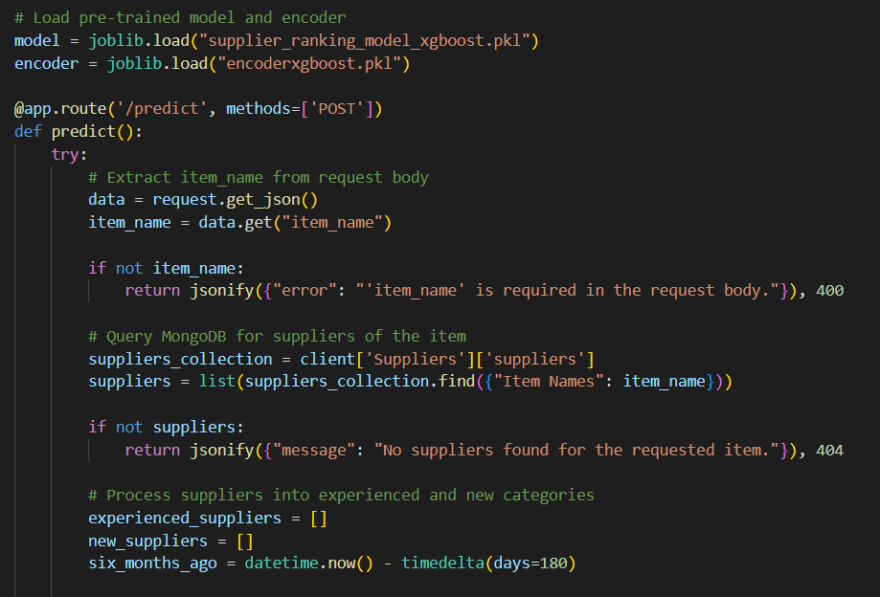
Developed part cont.
IT21312144 | Widanapathirana Y.R.| 24-25J-65

Slide 26
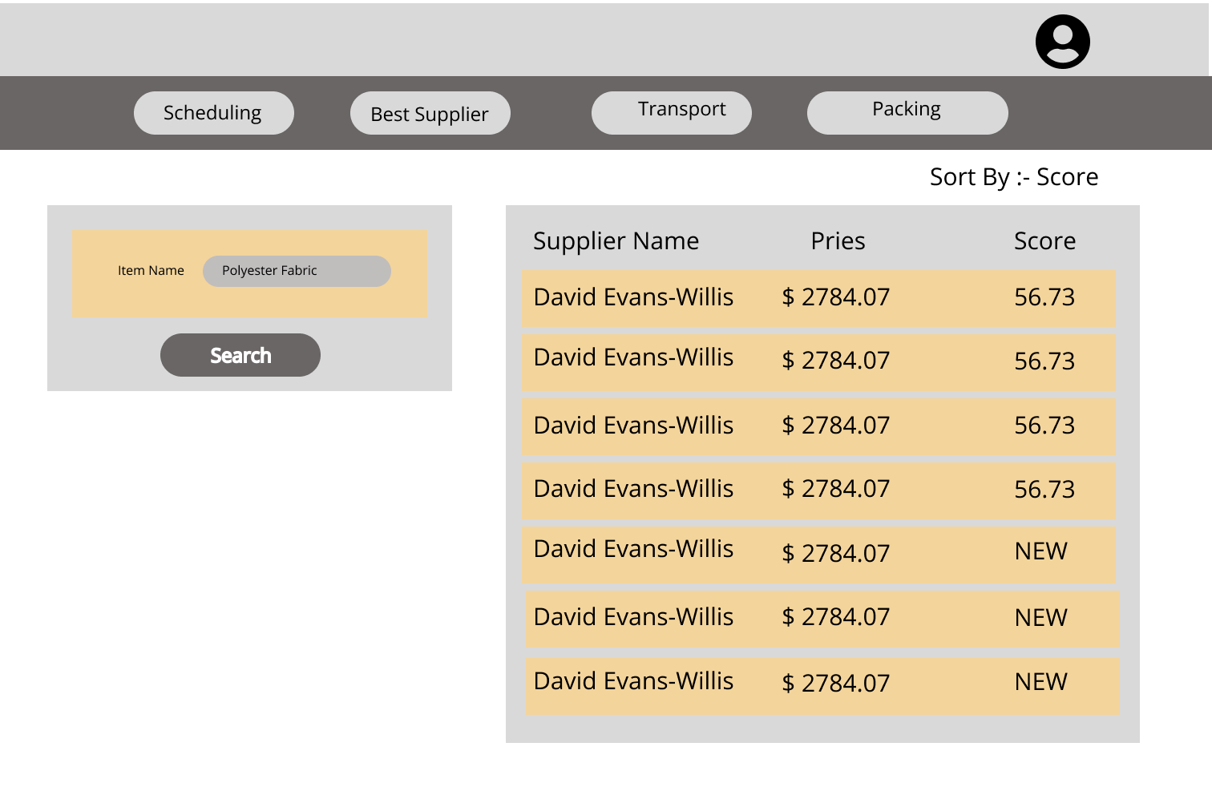
Prototype
IT21373848 | Weerasinghe WMSRM | R25-65

Slide 27
Commercial Value
Cost Reduction:
Highlight how the AI-driven approach reduces costs by optimizing supplier selection based on performance metrics such as price, delivery reliability, and defect rates.
Discuss the potential savings from reduced manual errors and improved efficiency.
Improved Supplier Relationships:
Showcase how the system fosters stronger supplier partnerships by consistently evaluating and rewarding top-performing suppliers.
Competitive Advantage:
Explain how leveraging real-time data and advanced analytics gives companies a competitive edge in the dynamic garment industry.
Enhanced Decision-Making:
Emphasize the value of data-driven decisions in improving procurement efficiency, lowering risks, and ensuring quality
IT21312144 | Widanapathirana Y.R.| 24-25J-65

Slide 28
References
SpringerLink, "Artificial Intelligence Procurement Assistant: Enhancing Bid Evaluation," SpringerLink, 2023.
Journal of Intelligent Manufacturing, "A Big Data Analytics System for Viable Supplier Selection," SpringerLink, 2023.
Axioms, "A Multi-Criteria Supplier Selection Model for Sustainable Automotive Supply Chain Under Uncertainty," SpringerLink, 2022.
IT21312144 | Widanapathirana Y.R.| 24-25J-65

Slide 29
IT21158704 | DILSHAN K.T.D.N
Software Engineering (SE)
IT21158704 | DILSHAN K.T.D.N | 24-25J-65

Slide 30
Individual Research Problem
How can AI algorithms and real-time data be utilized to optimize transportation routes and minimize delivery times and costs?
IT21158704 | DILSHAN K.T.D.N | 24-25J-65

Slide 31
Individual Objectives
Predict the most suitable vehicle type for a given delivery task based on
Calculate and recommend optimal or alternative routes for Multi-Warehouse Deliveries
Adjust routes or recommend alternative paths during challenging weather conditions
IT21158704 | DILSHAN K.T.D.N | 24-25J-65

Slide 32
Research Gap
Features | Proposed System | SAP Advanced Planning and Optimization [1] | Apparel Magic[2] | Uphance[3]
Real-time route optimization | ✔️ | ✔️ | ✔️ | ✔️
Predictive analytics for delays | ✔️ | ✔️ | ✔️ | ✔️
Alternative route suggestions | ✔️ | ❌ | ❌ | ✔️
Dynamic vehicle allocation | ✔️ | ❌ | ❌ | ❌
Real-time Traffic and Weather Updates | ✔️ | ❌ | ❌ | ❌
IT21158704 | DILSHAN K.T.D.N | 24-25J-65

Slide 33
Developed part
Implement the AI Model for suggest vehicle.
Model - Random Forest Classifier.
Developed API endpoint to retrieve data.
Completion - 50%
IT21158704 | DILSHAN K.T.D.N | 24-25J-65

Slide 34
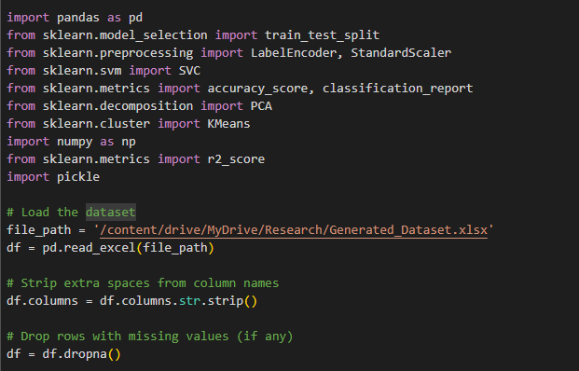
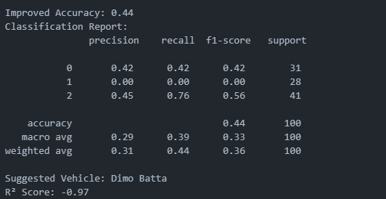
Developed part cont…
IT21158704 | DILSHAN K.T.D.N | 24-25J-65

Slide 35
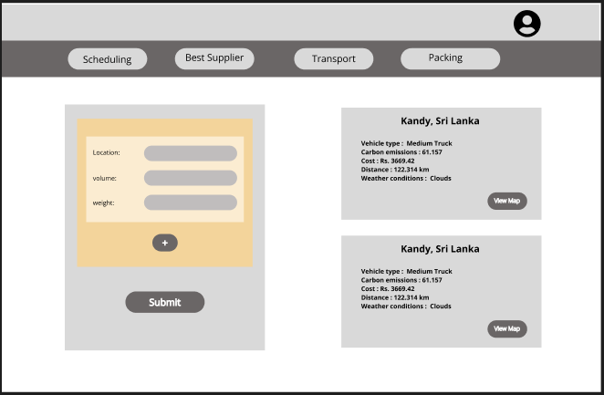
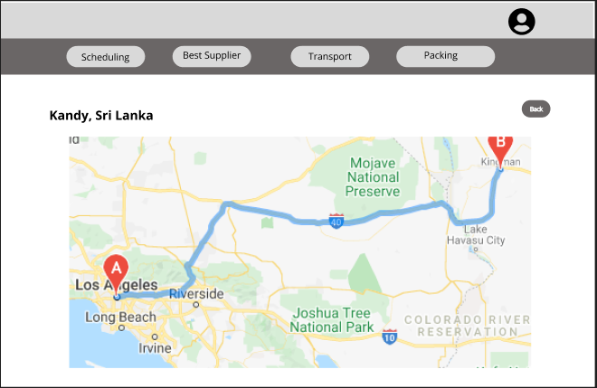
Developed part cont…
4. Create UI prototypes for the application.
Technology - Figma

Slide 36
Commercial Value
Efficient route planning and vehicle selection minimize fuel consumption, directly reducing operational costs.
Real-time route optimization reduces delays and ensures faster deliveries.
IT21158704 | DILSHAN K.T.D.N | 24-25J-65

Slide 37
References
[1]Penchev, P., Vitliemov, P., & Georgiev, I. (2023). Optimization model for production scheduling taking into account preventive maintenance in an uncertainty-based production system. Heliyon, 9(3), e17485.
https://doi.org/10.1016/j.heliyon.2023.03.17485
[2]Ginsberg, B. Supply Chain Management in the Apparel Industry. ApparelMagic. https://apparelmagic.com/supply-chain-management-in-the-apparel-industry
[3]"Revamp Your Apparel Supply Chain for Speed & Flexibility," Uphance. https://www.uphance.com/revamp-your-apparel-supply-chain-for-speed-flexibility
IT21158704 | DILSHAN K.T.D.N | 24-25J-65

Slide 38
IT21373848 | Weerasinghe WMSRM
Information Technology specialized in Software Engineering
IT21373848 | Weerasinghe WMSRM | 24-25J-65

Slide 39
Individual Research Problem
How can we optimize carton packing and predict loading times using algorithms and machine learning for efficient garment logistics?
IT21373848 | Weerasinghe WMSRM | 24-25J-65

Slide 40
Individual Objectives
To develop a solution that optimizes carton packing by maximizing space and adhering to weight limits, while accurately predicting loading times using machine learning for efficient garment logistics.
IT21373848 | Weerasinghe WMSRM | 24-25J-65

Slide 41
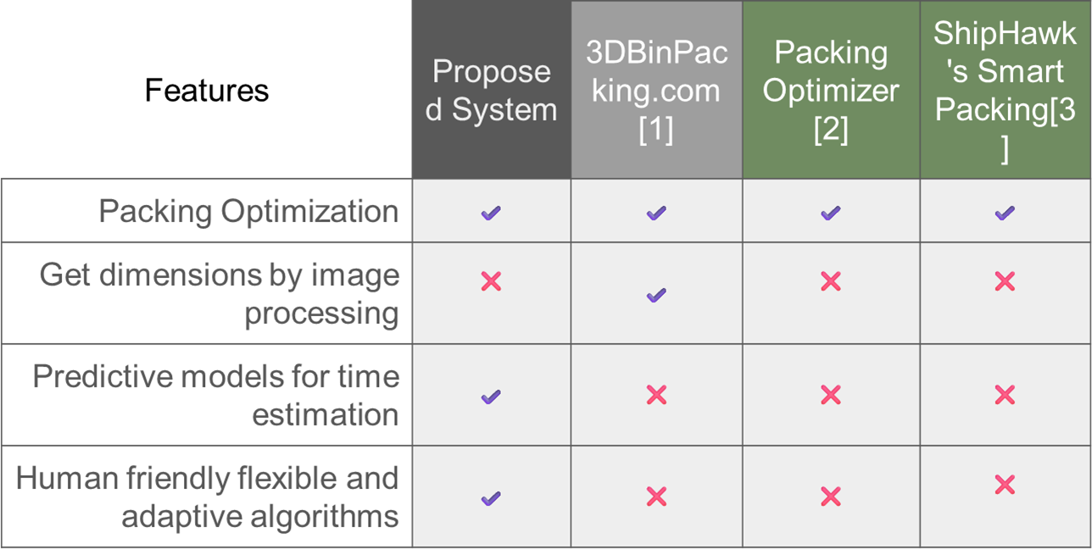
Research Gap
IT21373848 | Weerasinghe WMSRM | 24-25J-65

Slide 42
Research Gap
Existing solutions for carton packing and loading focus either on space optimization or time prediction but fail to integrate both effectively. There is a lack of comprehensive systems that consider box types, weight limits, vehicle dimensions, and accurately predict loading times for garment logistics.
Provides a human-friendly algorithm that balances efficiency with ease of implementation for manual loaders, particularly in garment logistics.
IT21373848 | Weerasinghe WMSRM | 24-25J-65

Slide 43
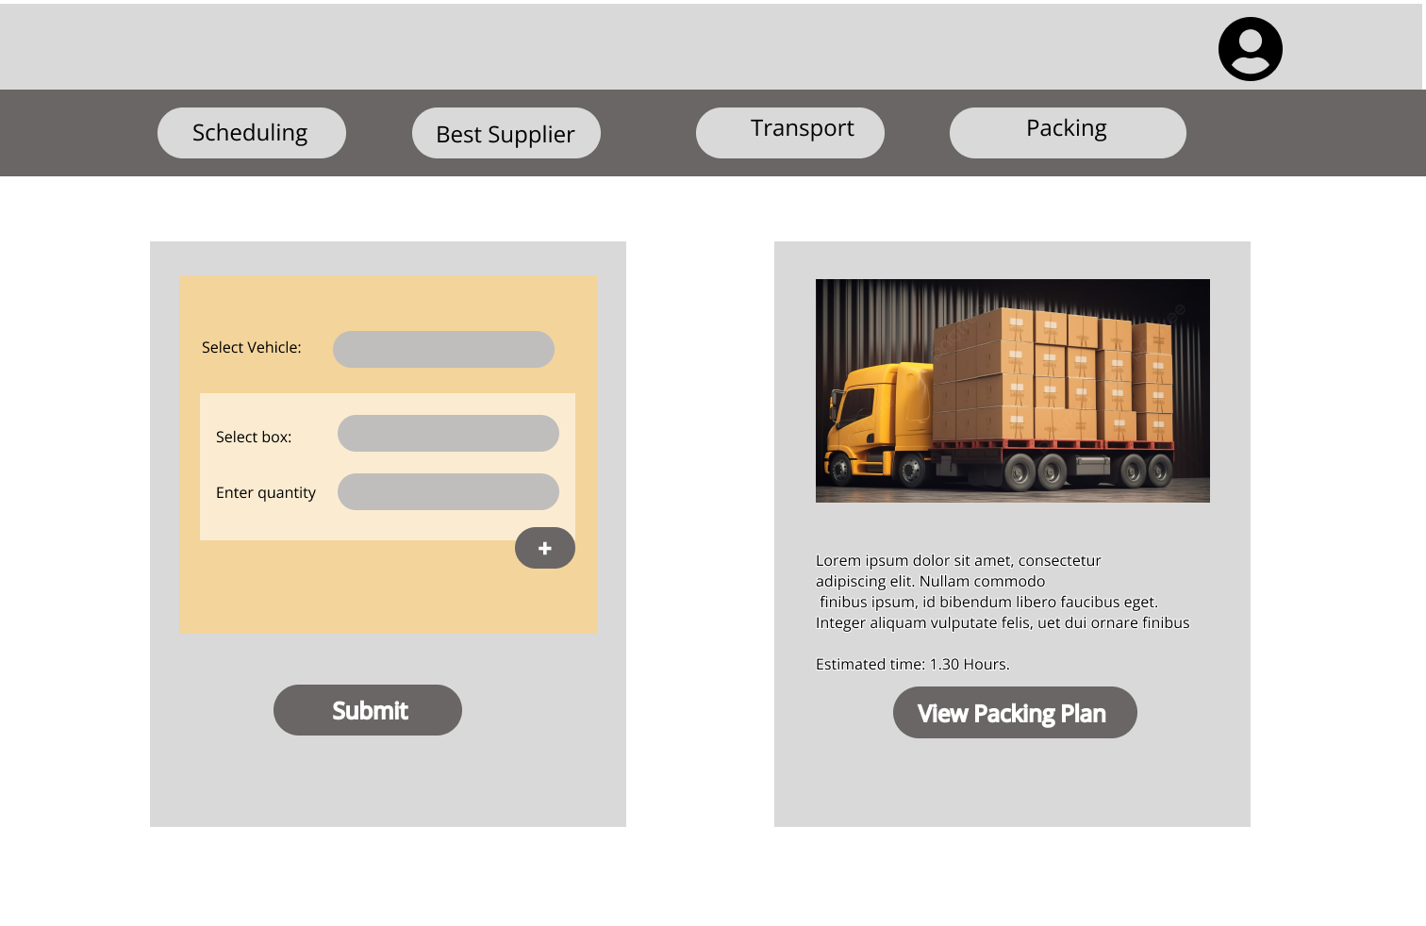
Prototype
IT21373848 | Weerasinghe WMSRM | R25-65

Slide 44
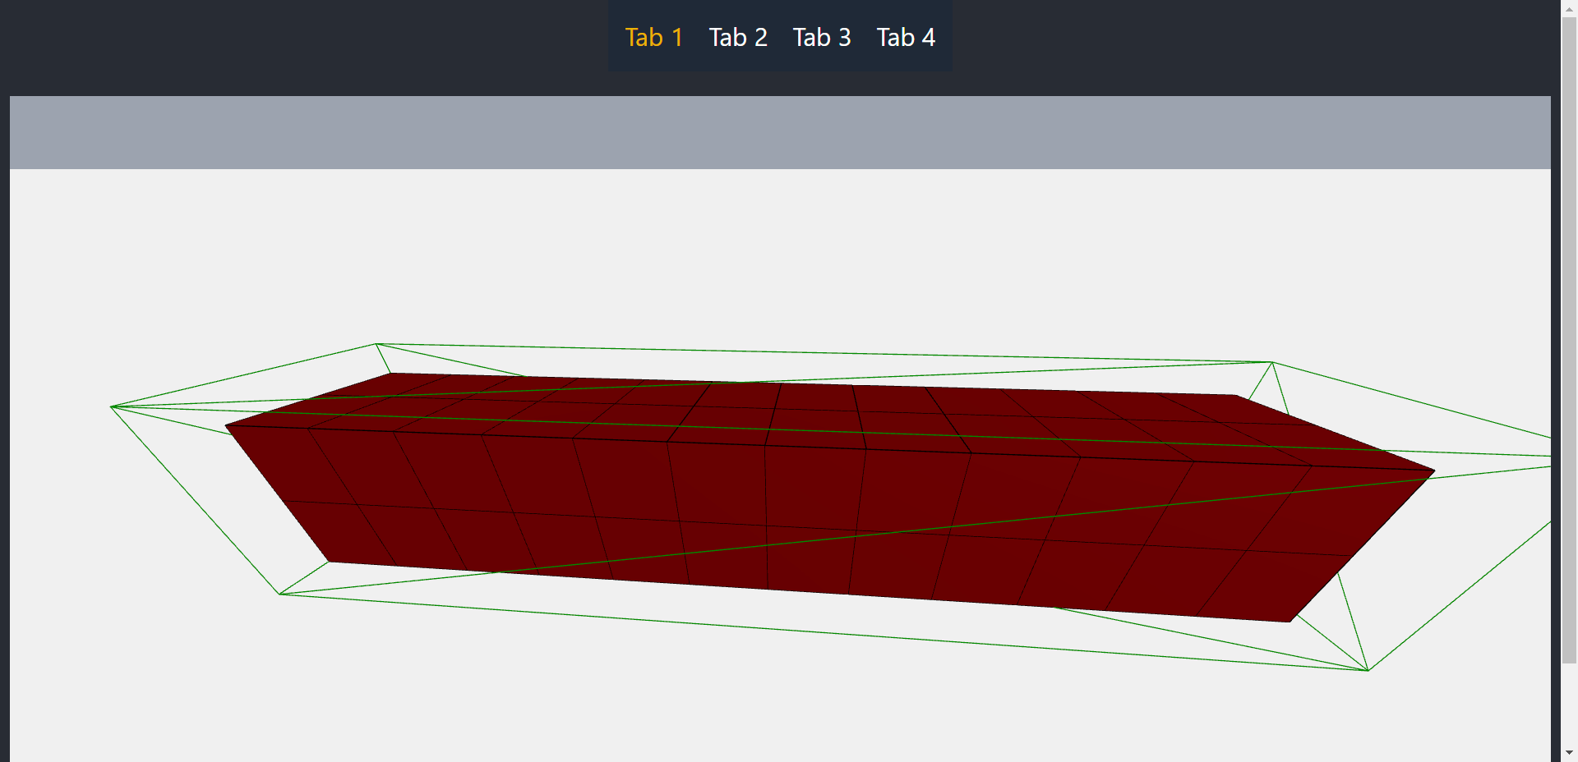
Developed part
3D model
IT21373848 | Weerasinghe WMSRM | 24-25J-65

Slide 45
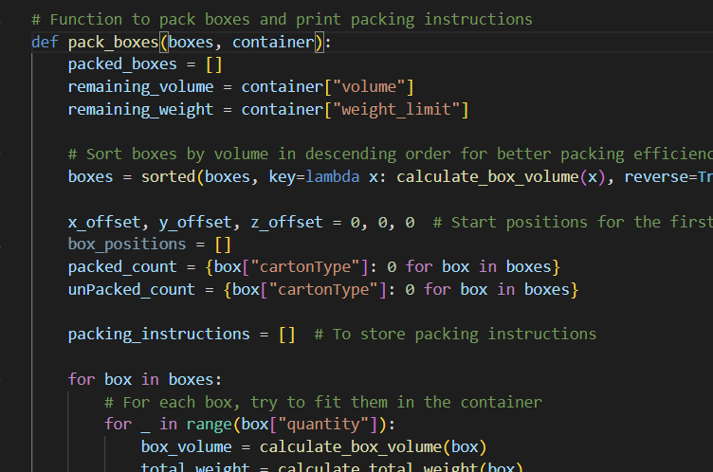
Developed part
IT21373848 | Weerasinghe WMSRM | 24-25J-65

Slide 46
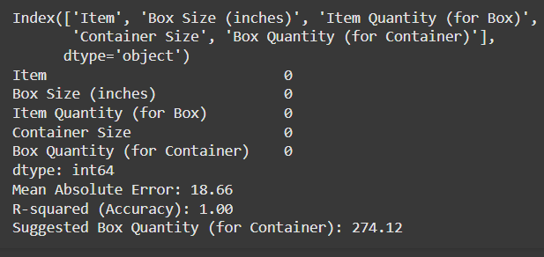
Developed part
IT21373848 | Weerasinghe WMSRM | 24-25J-65

Slide 47
Commercial Value
Saves Costs: Better packing reduces space and transport costs.
Saves Time: Predicts loading time to avoid delays.
Uses Resources Well: Maximizes vehicle space.
Works for All: Fits different box types and vehicle sizes.
Gives an Edge: Makes logistics faster and more efficient.
IT21373848 | Weerasinghe WMSRM | 24-25J-65

Slide 48
References
[1] 3DBinPacking.com, "3D Bin Packing," Available at: https://www.3dbinpacking.com/. Accessed on: Dec. 4, 2024.
[2] Packing Optimizer, "Packing Optimizer," Available at: https://www.packingoptimizer.com/. Accessed on: Dec. 4, 2024.
[3] ShipHawk's Smart Packing, "Smart Packing Solutions," Available at: https://www.shiphawk.com/smart-packing/. Accessed on: Dec. 4, 2024.
IT21373848 | Weerasinghe WMSRM | 24-25J-65

Slide 49
Conclusion
●Integrated AI Solutions
●Efficiency & Cost Reduction
●Real-Time Adaptability

